Slide 1
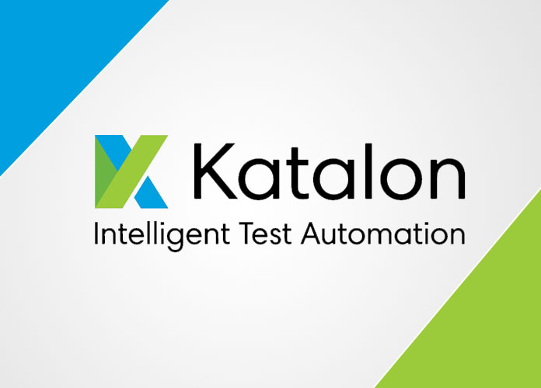
Katalon

Slide 2

What is Katalon?

Slide 3
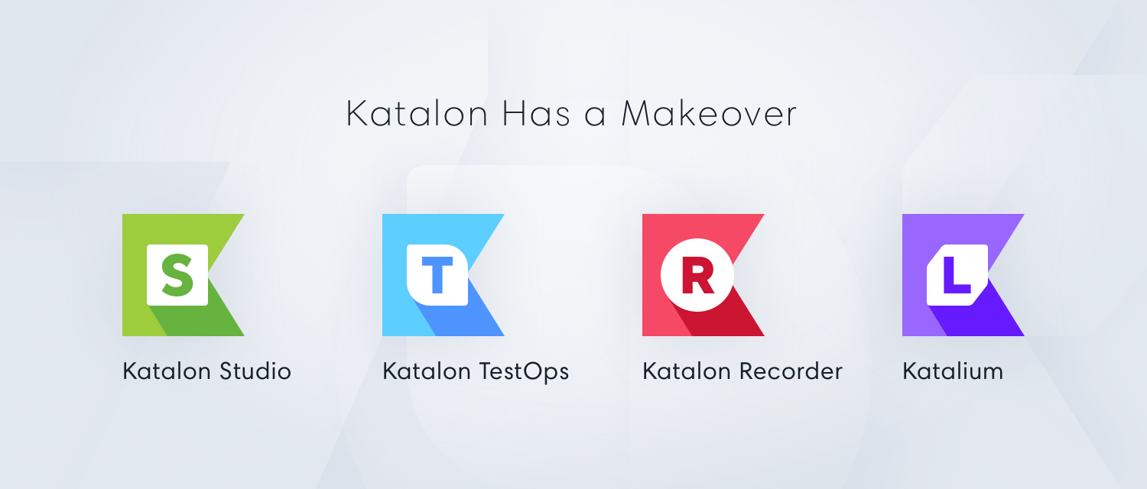
Katalon
Katalon Studio
Katalon Recorder
Katalon TestOps
Katalium

Slide 4

Katalon Studio

Slide 5
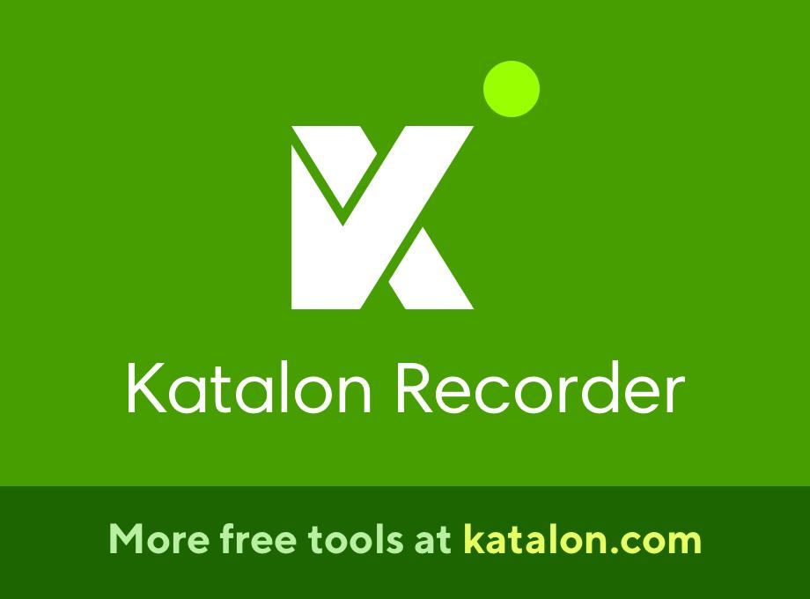
Katalon Recorder

Slide 6
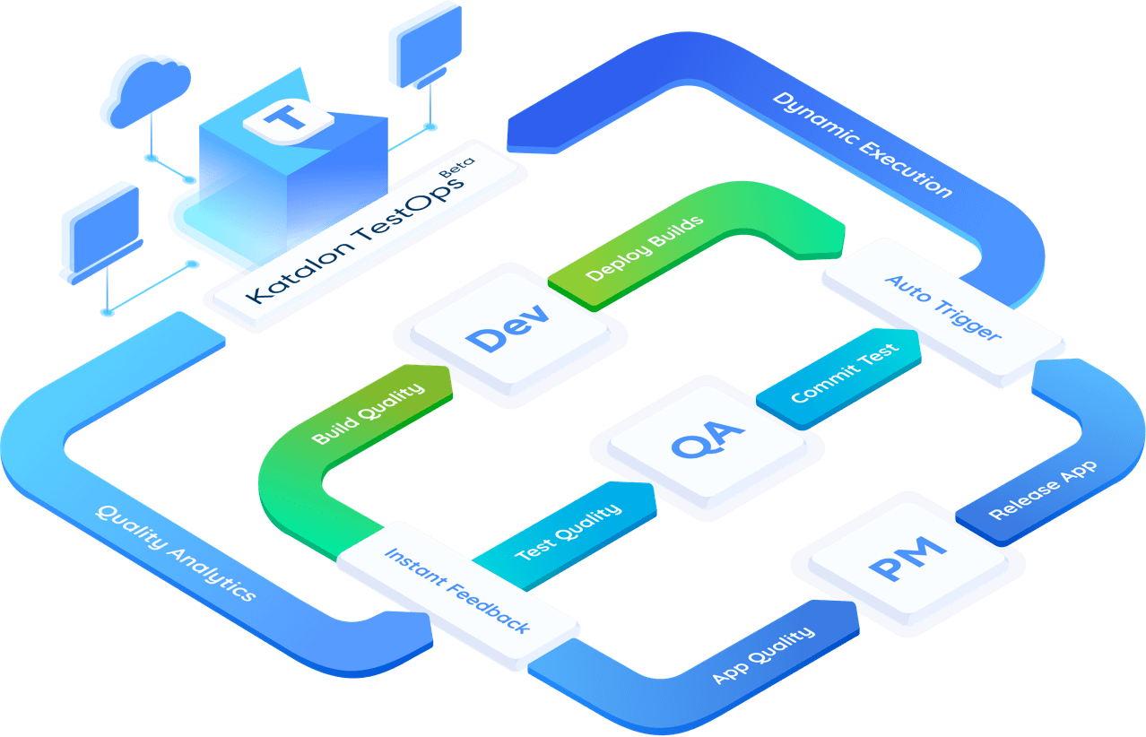
Katalon TestOps

Slide 7
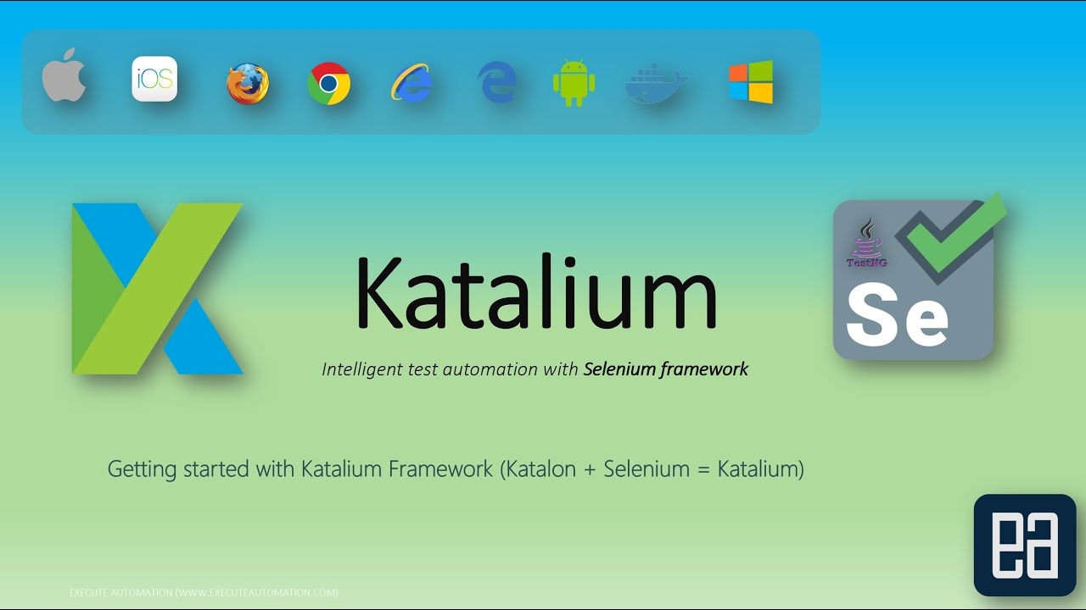
Katalium

Slide 8
Features of katalon studio

Slide 9
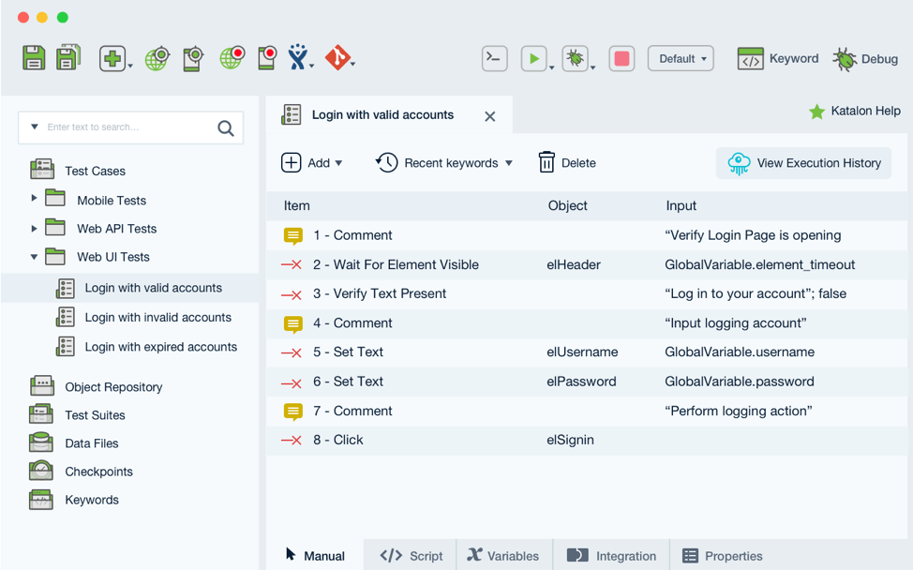
You can Setup & Start up tests easily..

Slide 10
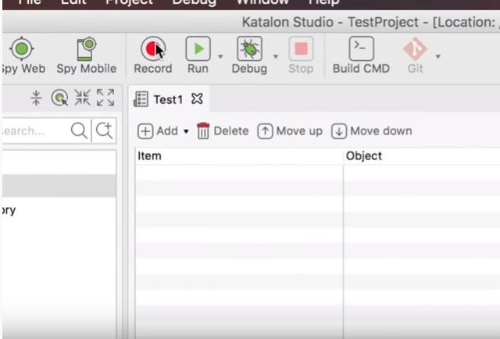
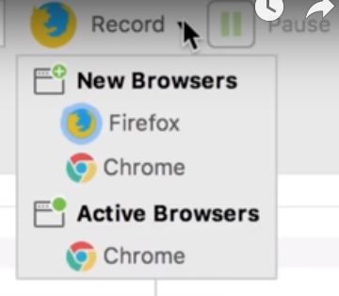
Record & Playback Actions..
It supports to new users
Save user’s time
You can run your test case on multiple browsers..

Slide 11
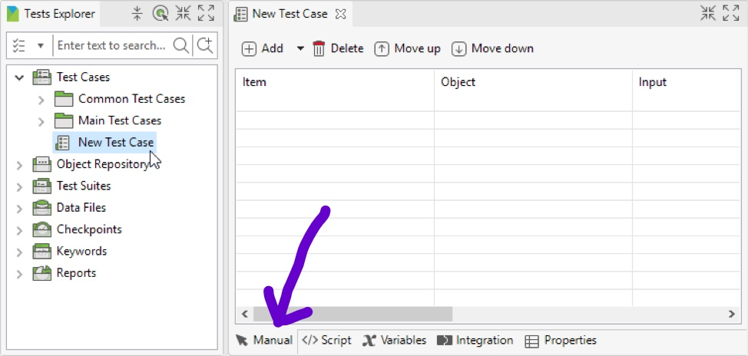
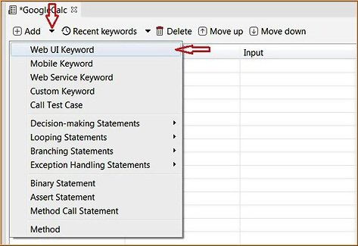
Test cases in manual & Script views..
If you are a new to use this tool,choose manual mode to easily test your software.

Slide 12
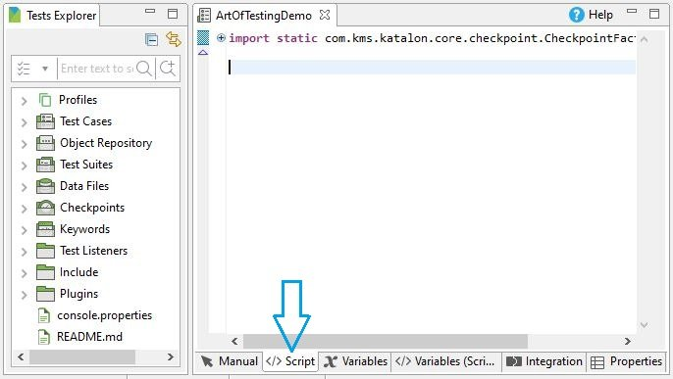
If you are a good one in programing you can choose script mode..
But it allows to do your program only java or groovy languages..

Slide 13
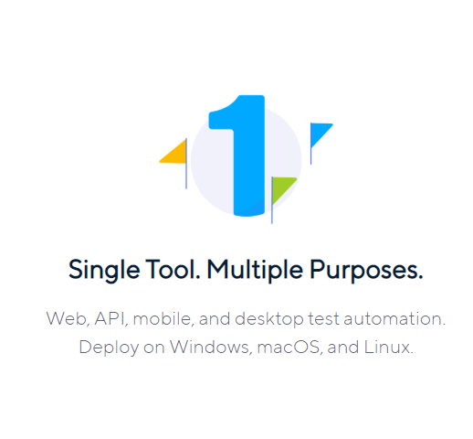
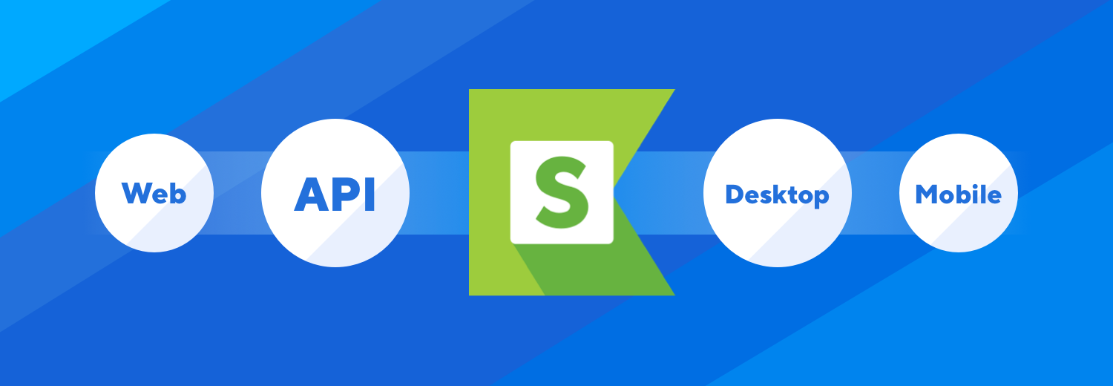
Advantages…
Supports different kinds of applications
Notes:
Katon supports web API desktop and mobile testing, in mobile we can go for either android or iOS, actually this is a single tool which gives alternation to many other tools like if u talk about selenium that is giving support only on web base and if we talk about soapUI that is giving support only web services

Slide 14
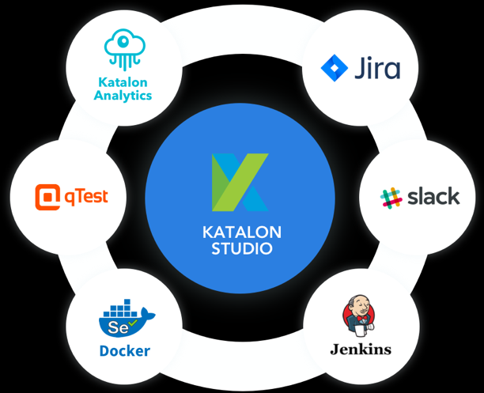
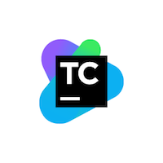
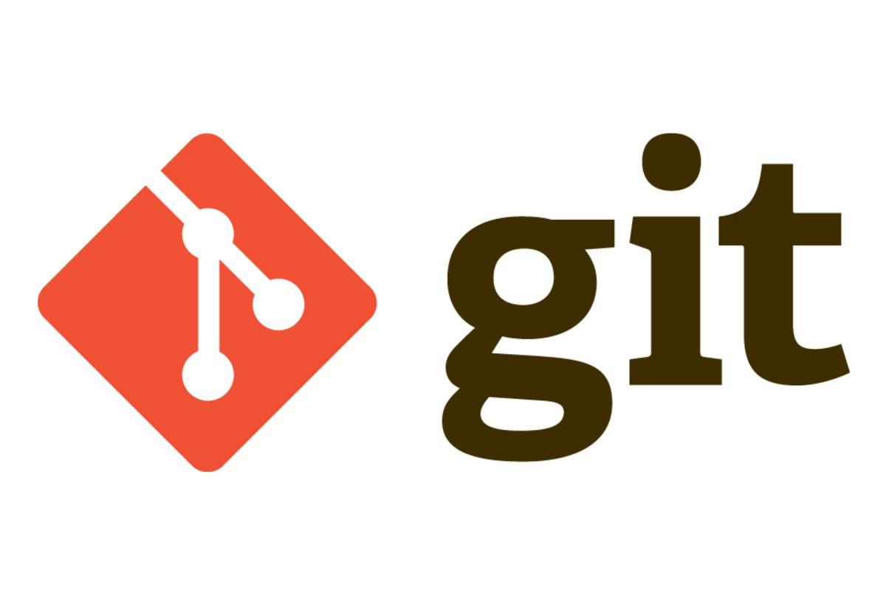
built-in integrations with various platforms
Git
Jira
Jenkins
Qtest
slack
TeamCity
Notes:
Katalon Studio has a system of built-in integrations with various platforms such as Jira, Jenkins, qTest,,Slack and so on, that helps optimize automation efficiency.

Slide 15
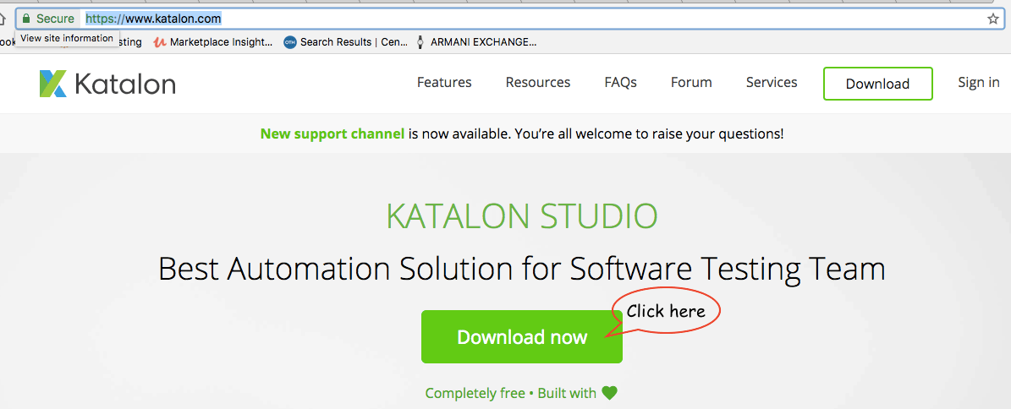
Free
https://www.katalon.com/
Support parallel execution
Notes:
Katalon studio is completely free we can easily download it by using

Slide 16
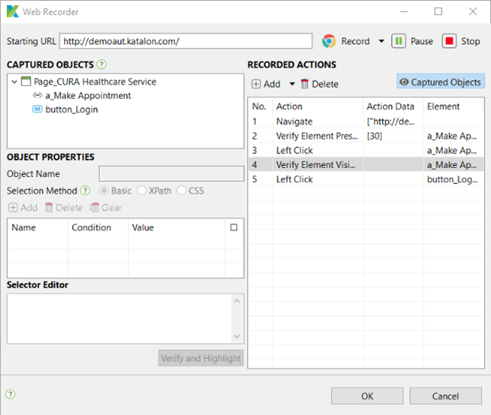
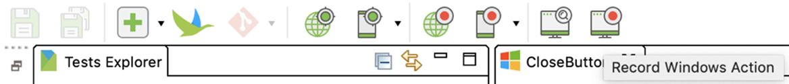
Easy to use
Very basic coding is required
Notes:
Katalon is user friendly tool with rich graphics with tree views, tables, and build in keywords even a beginner can easily understand. Lot of things we can do by just drag and drop
Unlike other testing tools Katalon Studio is a flexible for users either with or without coding skills. Can do testing without any problem

Slide 17
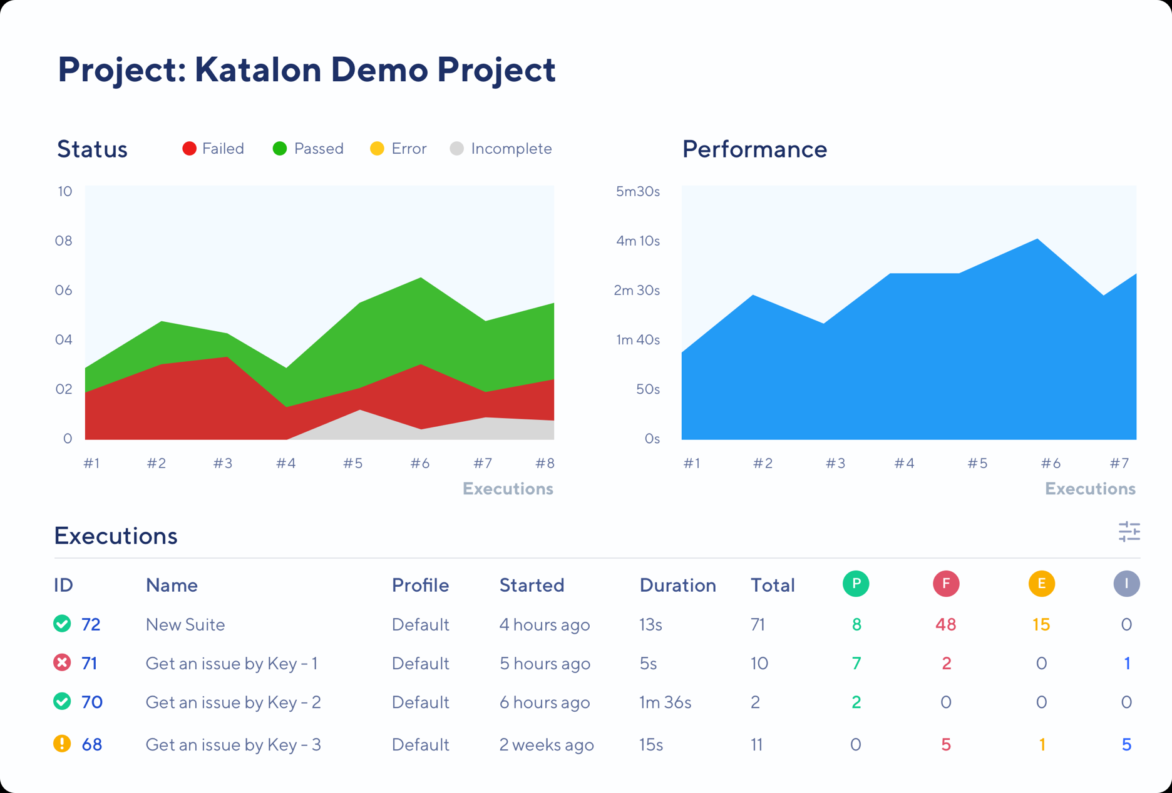

Can get better understanding of test executions of multiple projects in real time.
Notes:
And the katalon has their own built in reporting system.,katalon analytics.

Slide 18



Disadvantages…
Unlike tools like Selenium the script creation is limited to Java and Groovy only

Slide 19
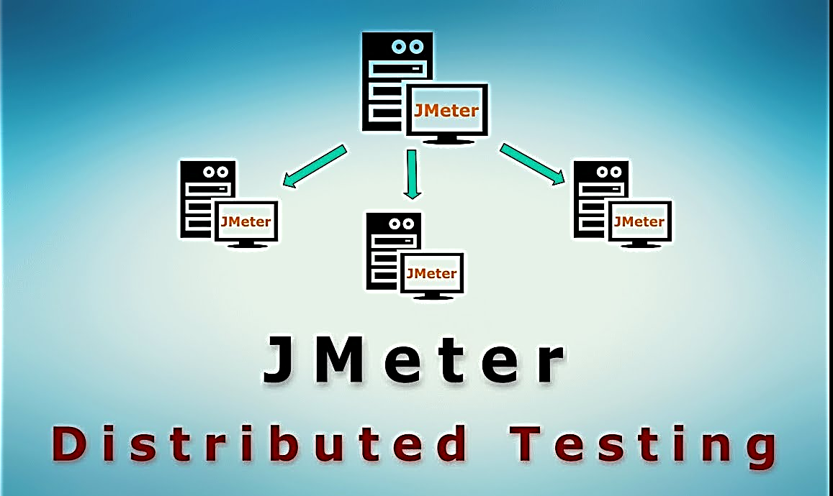
As of now there is no support for distributed testing

Slide 20

Not open source The tool has a closed source code, resulting in a smaller number of developers in the community. Selenium, one of the main competitors to Katalon, is an open-source tool that allows engineers to customize it

Slide 21
Documentation is somehow not detailed enough and the community is smaller than other commercial tools

Slide 22
Alternatives for Katalon

Slide 23




Free Software

Slide 24



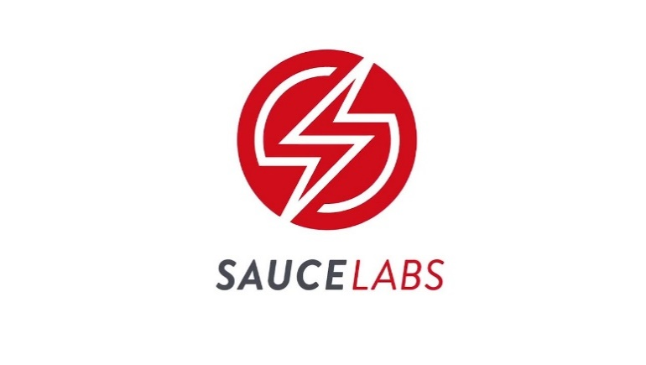
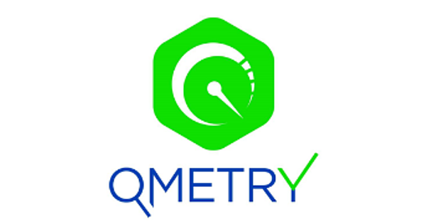
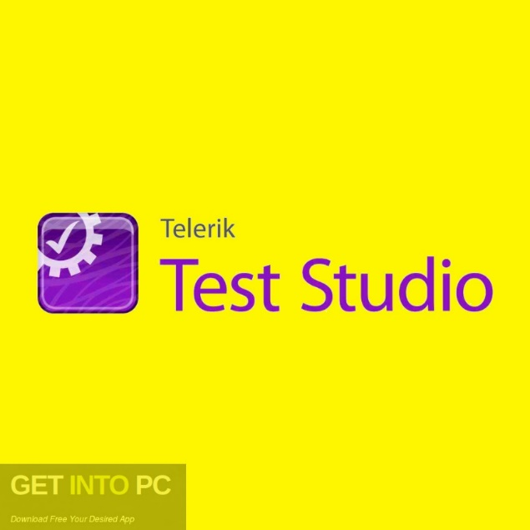

Freemium and Premium Softwares

Slide 25
Katalon Vs. Selenium
Features | Katalon | Selenium
Test development platform | Cross-platform | Cross-platform
Application under test | Web and mobile apps | Web apps
Scripting languages | Java/Groovy | Java, C#, Perl, Python, JavaScript, Ruby, PHP
Programming skills | Not required. Recommended for advanced test scripts | Advanced skills needed to integrate various tools
Learning curves | Medium | High
Ease of installation and use | Easy to setup and run | Require installing and integrating various tools
Script creation time | Quick | Slow
Object storage and maintenance | Built-in object repository, XPath, object re-identification | XPath, UI Maps
Image-based testing | Built-in support | Require installing additional libraries
DevOps/ALM integrations | Many | No (require additional libraries)
Continuous integrations | Popular CI tools (e.g. Jenkins, TeamCity) | Various CI tools (e.g. Jenkins, Cruise Control)
Test Analytics | Katalon Analytics | No
Product support | Ticketing support, community, dedicated staff (third-party support services) | Open source community
License type | Freeware | Open source (Apache 2.0)
Cost | Free | Free

Slide 26
Thank you..

